Slide 1
MetaWBC: POSIX-Compliant Metadata Write-Back Caching for Distributed File Systems
Yingjin Qian¹, Wen Cheng^{2,3}, Lingfang Zeng³, Marc-André Vef⁴, Oleg Drokin⁵, Andreas Dilger⁵, Shuichi Ihara¹, Wusheng Zhang⁶, Yang Wang⁷, André Brinkmann⁴
¹ Data Direct Networks
² Huazhong University of Science & Technology
³ Zhejiang Lab
⁴ Johannes Gutenberg University Mainz
⁵ Whamcloud
⁶ Tsinghua University
⁷ SIAT, Chinese Academy of Sciences

Slide 2
Motivation
Metadata challenges and goals
Distributed file systems (DFSs) use caching to improve file system performance
  Write-back caches for data performance
  Write-through caches for metadata to simplify consistency protocols
Metadata can account for >50% of all file system operations
Metadata performance suffers from various challenges in modern DFSs
  Synchronous operations
  High network round trip latency
  Lock contention
  Heavy RPC loads for namespace flush

Slide 3
Motivation
Metadata challenges and goals
Distributed file systems (DFSs) use caching to improve file system performance
  Write-back caches for data performance
  Write-through caches for metadata to simplify consistency protocols
Metadata can account for >50% of all file system operations
Metadata performance suffers from various challenges in modern DFSs
  Synchronous operations
  High network round trip latency
  Lock contention
  Heavy RPC loads for namespace flush
Filebench varmail performance

Slide 4
Motivation
Metadata challenges and goals
Distributed file systems (DFSs) use caching to improve file system performance
  Write-back caches for data performance
  Write-through caches for metadata to simplify consistency protocols
Metadata can account for >50% of all file system operations
Metadata performance suffers from various challenges in modern DFSs
  Synchronous operations
  High network round trip latency
  Lock contention
  Heavy RPC loads for namespace flush
Filebench varmail: Average latency for each I/O operation

Slide 5
MetaWBC
Goals and contributions
We propose MetaWBC to alleviate DFS metadata challenges
Key points and contributions:
A novel Metadata Write-Back Caching mechanism on the client nodes
Retains strong POSIX-compliance and solves flush dependencies
Uses a new POSIX-compatible memory file system: MemFS
Based on a file caching state machine
Offers various optimizations, e.g., for removals, flushes, and batching
Exemplar implementation in the Lustre distributed parallel file system

Slide 6
Background
Lustre basic architecture
Terminology
MDS: Metadata Server
  Processes metadata requests
MDT: Metadata Target
  Stores metadata content
  Manages file access
  Pathname, UID, GID, ctime, …
  Permissions, ACLs, xattrs
OSS: Object Storage Server
  Processes I/O requests
OST: Object Storage Target
  Stores data content
  File sizes, blocks count, mtime
Lustre architecture
Qian et al. "A configurable rule based classful token bucket filter network request scheduler for the lustre file system.”, SC17

Slide 7
Background
Lustre Distributed Lock Manager (DLM)
Lustre DLM used for file synchronization and metadata access
A lock corresponds to a certain resource ID in a namespace (NS)
  Each Lustre target (OST, MDT, MGT) has a DLM namespace
  Each Lustre target has full authority about its namespace
Clients have a copy of a server lock for locally-accessed resources (shadow namespaces)
Several lock modes are used:
Mode | Name | Meaning
EX | Exclusive | No other process can get R or W access
PW | Prot. Write | No other process can get W access
PR | Prot. Read | No other process can get W access
CW | Conc. Write | No restrictions
CR | Conc. Read | No restrictions
NL | Null | Indicates interest into resource
Most restrictive
Least restrictive
Shadow namespaces on clients
P. Braam. “The Lustre Storage Architecture”. 2005
Wang et al. "Understanding Lustre filesystem internals.”, 2009

Slide 8
MetaWBC
Architecture
MemFS is used for an efficient hierarchical metadata and data cache on client nodes
MetaWBC leverages Lustre’s distributed lock manager (DLM) for global coherency
  Exclusive (EX) lock mechanism used to provide a strongly consistent view of cached directories
  EX lock attained on mkdir(), or via namespace de-rooting (inheriting EX subdirectory lock)
  DLM revokes locks from MetaWBC when cached directories are accessed by other nodes
  General concept can be adopted by other DFSs using a DLM

Slide 9
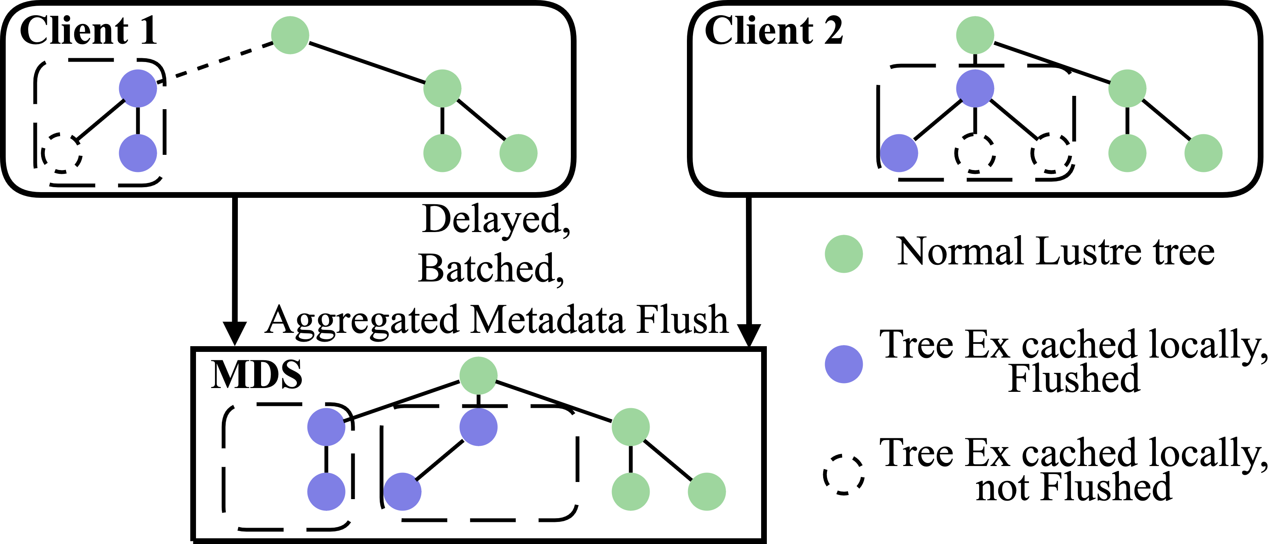
MetaWBC
MemFS
MemFS key points:
Developed for MetaWBC with design and implementation similar to tmpfs
Hooks into Linux VFS for memory pressure/flushing
Offers support to persist data and metadata to the backend DFS
Visible namespace for MetaWBC cached in MemFS

Slide 10
MetaWBC
POSIX-compliance & flush-back
When is metadata cached on the client?
  When a directory is created (e.g., via the mkdir command)
  Metadata of all created files/subdirs in this directory can automatically be cached locally
Notes:
Sync: flush everything: first sync data then metadata
Fsync: flush data of fd, sync inode after

Slide 11
MetaWBC
POSIX-compliance & flush-back
When is metadata cached on the client?
  When a directory is created (e.g., via the mkdir command)
  Metadata of all created files/subdirs in this directory can automatically be cached locally
When is metadata flushed back to the Lustre MDS?
  When MemFS capacity threshold is reached or maximum inode limit is breached
  When fsync() or sync() is called
  On conflicting access from remote client nodes revoking the EX lock
    De-root and inherit EX lock on all subdirectories
Notes:
Sync: flush everything: first sync data then metadata
Fsync: flush data of fd, sync inode after

Slide 12
MetaWBC
POSIX-compliance & flush-back
When is metadata cached on the client?
  When a directory is created (e.g., via the mkdir command)
  Metadata of all created files/subdirs in this directory can automatically be cached locally
When is metadata flushed back to the Lustre MDS?
  When MemFS capacity threshold is reached or maximum inode limit is breached
  When fsync() or sync() is called
  On conflicting access from remote client nodes revoking the EX lock
    De-root and inherit EX lock on all subdirectories
MetaWBC further uses the periodic flush algorithm of Linux’s write-back cache
  Flush-back interval every five seconds (Linux default interval)
  Reduces the number of dirty inodes to flush when EX lock is revoked
Notes:
Sync: flush everything: first sync data then metadata
Fsync: flush data of fd, sync inode after

Slide 13
MetaWBC
POSIX-compliance & flush-back
When is metadata cached on the client?
  When a directory is created (e.g., via the mkdir command)
  Metadata of all created files/subdirs in this directory can automatically be cached locally
When is metadata flushed back to the Lustre MDS?
  When MemFS capacity threshold is reached or maximum inode limit is breached
  When fsync() or sync() is called
  On conflicting access from remote client nodes revoking the EX lock
    De-root and inherit EX lock on all subdirectories
MetaWBC further uses the periodic flush algorithm of Linux’s write-back cache
  Flush-back interval every five seconds (Linux default interval)
  Reduces the number of dirty inodes to flush when EX lock is revoked
MetaWBC does not impact Lustre’s strong consistency semantics

Slide 14
MetaWBC
POSIX-compliance & flush-back
However, POSIX does not consider flush dependencies
  Flushing file inodes without their parent directory inode is valid in POSIX
  Default behavior for local Ext2 filesystems
  Could cause inconsistent file system state (unreachable files/directories) in the event of failure
Linux’s write-back mechanism is not aware of hierarchical dependencies
MetaWBC explicitely handles these flush dependencies
  Backtrack to first flushed parent directory
  Synchronize directory tree in top-down order

Slide 15
MetaWBC
Caching state machine
MetaWBC assigns caching state flags to inodes
  Root (R): Cached subtree root and holder of EX lock
  Protected (P): Directly or indirectly protected by EX DLM lock
  Flushed (F): Metadata has been flushed
  Complete (C): Directory flag indicating entire subtree is cached
  Assimilated (A): Regular file flag indicating cached file pages have been flushed
  None (N): Not managed by MemFS

Slide 16
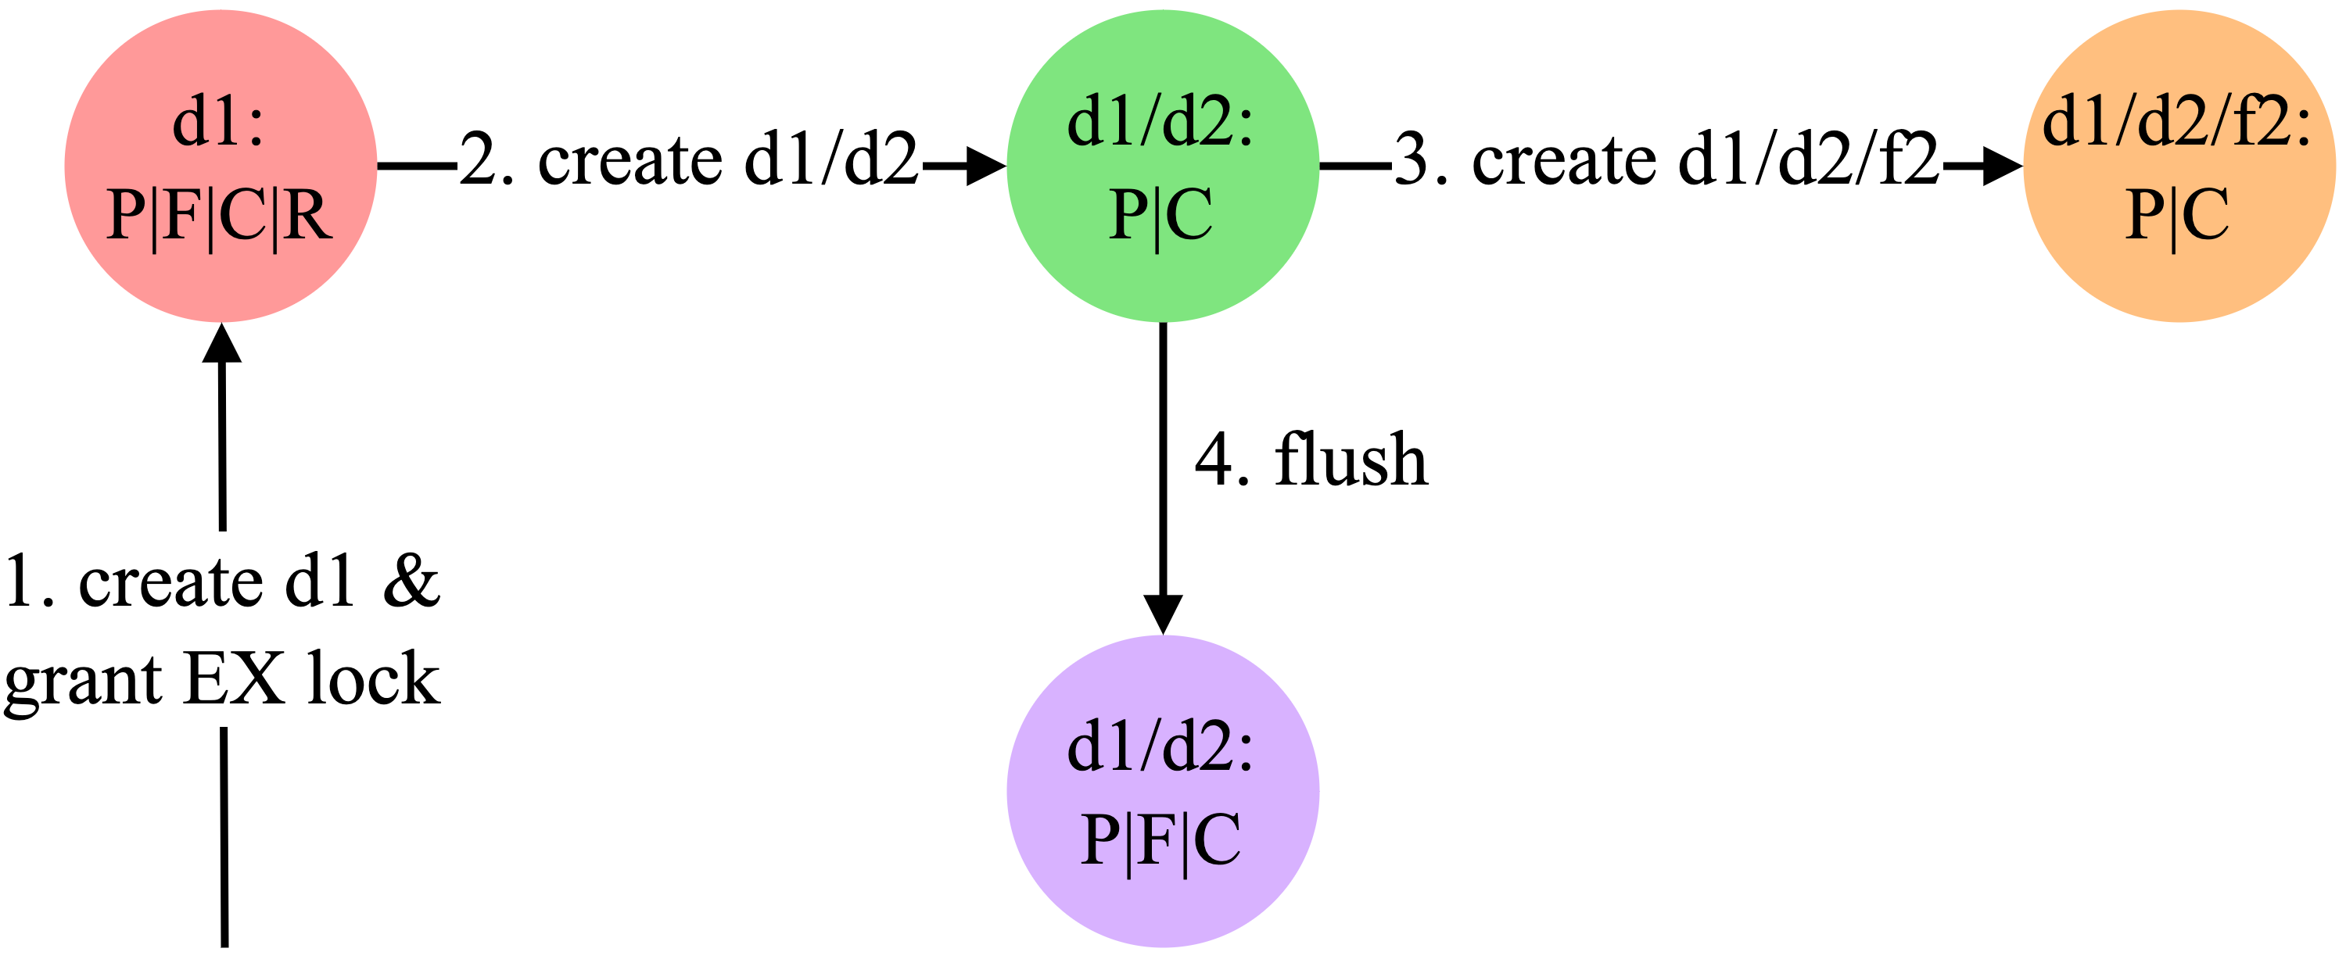
MetaWBC
Caching state machine
MetaWBC assigns caching state flags to inodes
  Root (R): Cached subtree root and holder of EX lock
  Protected (P): Directly or indirectly protected by EX DLM lock
  Flushed (F): Metadata has been flushed
  Complete (C): Directory flag indicating entire subtree is cached
  Assimilated (A): Regular file flag indicating cached file pages have been flushed
  None (N): Not managed by MemFS
Creation and flush work flow
d1 created on server with EX lock
d2 created locally
f2 created locally
d2 flushed by age, space

Slide 17
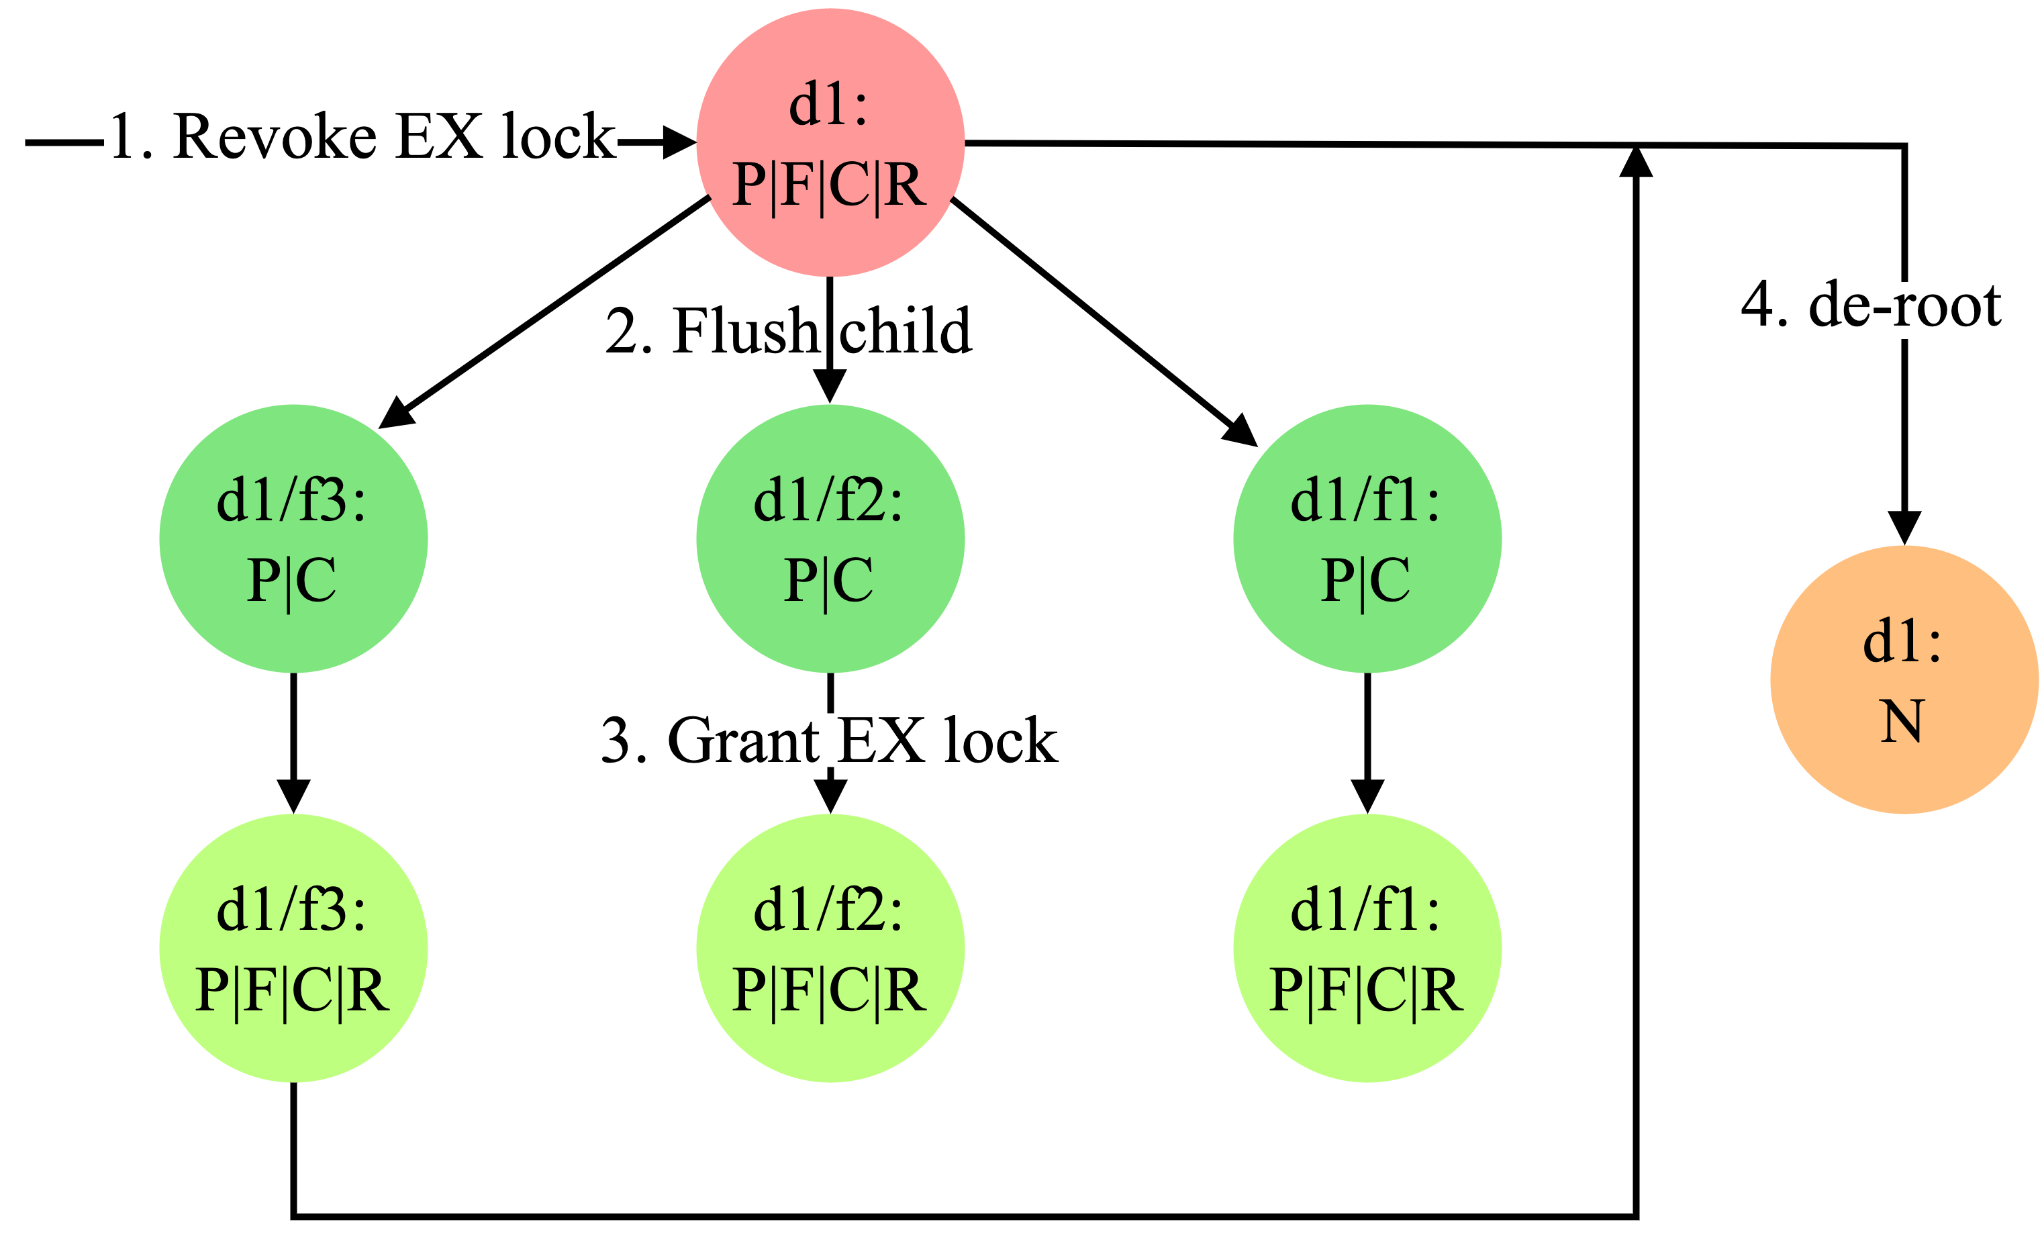
MetaWBC
Caching state machine
MetaWBC assigns caching state flags to inodes
  Root (R): Cached subtree root and holder of EX lock
  Protected (P): Directly or indirectly protected by EX DLM lock
  Flushed (F): Metadata has been flushed
  Complete (C): Directory flag indicating entire subtree is cached
  Assimilated (A): Regular file flag indicating cached file pages have been flushed
  None (N): Not managed by MemFS
De-root work flow
Conflict/age/space on d1
Flush all top-level entries of d1
EX lock on all top-level entries
Drop d1 lock
Repeat on as needed
Notes:
De-complete workflow describing workflow when limit is reached

Slide 18
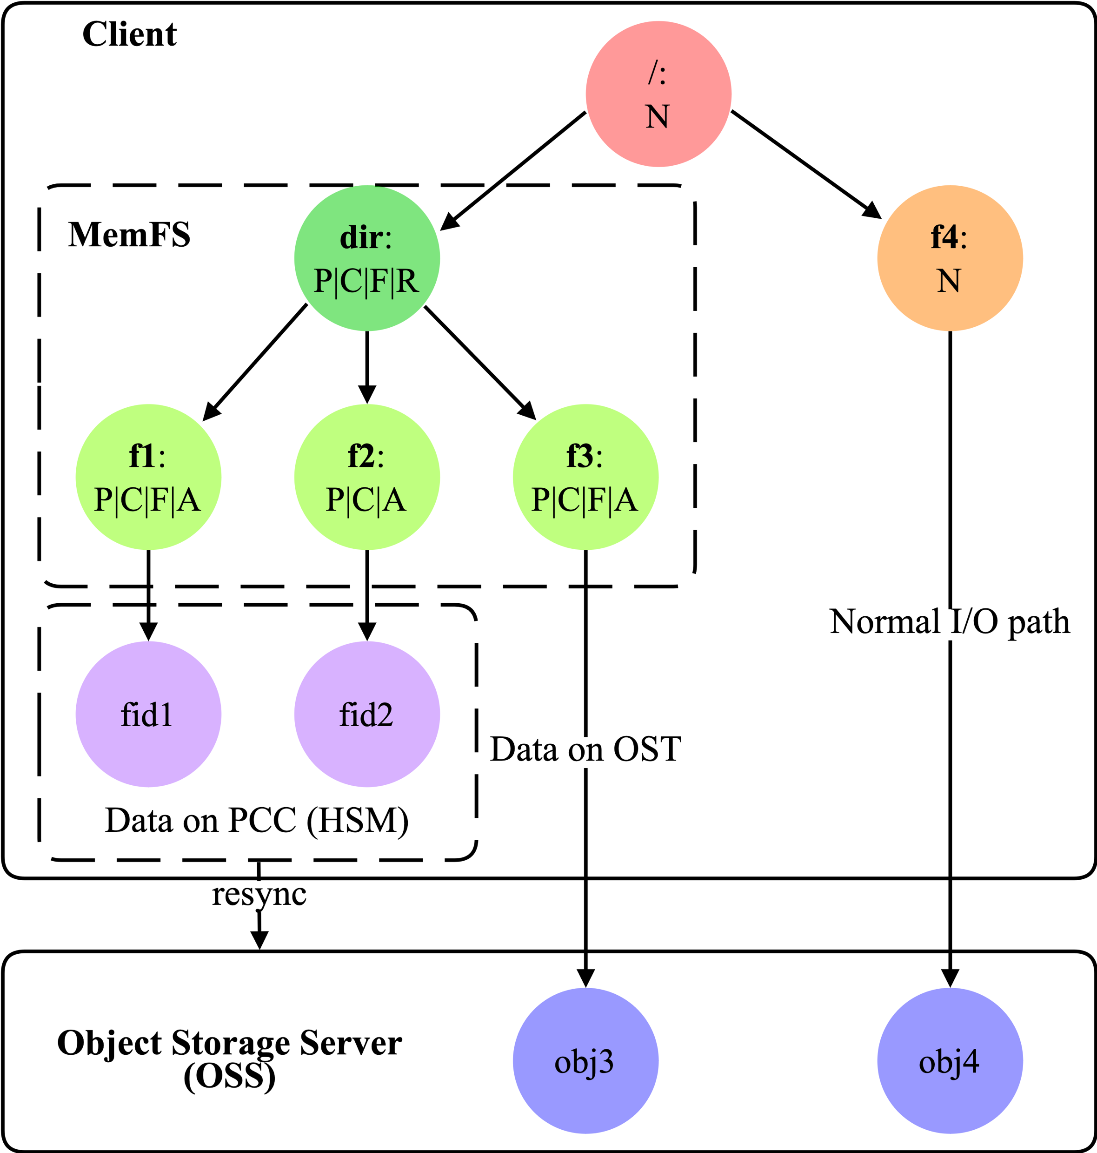
MetaWBC
Further features & optimizations
Features
  Integration into Lustre Persistent Client Cache
  Cache reclaim
  Space management
Optimizations
  Metadata merging and batching
    Reduce number of RPCs
  Asynchronous parallel flush
    Detect metadata-intensive workloads
    Asynchronously flush directory contents in parallel
  Removal strategies
    Asynchronous delayed removal
MetaWBC integration into Lustre Persistent Client Cache

Slide 19
Evaluation
Test bed
Lustre 2.14.0 cluster with CentOS 8.4
  1 Meta Data Target (MDT)
  8 Object Storage Targets (OSTs)
  Servers using DDN AI400X Appliance (20x Samsung 3.84 TiB NVMe, 4×IB-HDR100)
  32 client nodes using Intel Gold 5218 processor, 96 GiB DDR4 RAM, IB-HDR 100
Max. number of inodes in MemFS: 2,000,000
Max. page cache size on clients: 16 GiB
Evaluate MetaWBC in micro benchmarks and real-world workloads
MetaWBC comparison with Ext4, NFS, tmpfs, and CephFS
Notes:
Compare MetaWBC with CephFS as it supports asynchronous directory operations

Slide 20
Evaluation
Test bed
Lustre 2.14.0 cluster with CentOS 8.4
  1 Meta Data Target (MDT)
  8 Object Storage Targets (OSTs)
  Servers using DDN AI400X Appliance (20x Samsung 3.84 TiB NVMe, 4×IB-HDR100)
  32 client nodes using Intel Gold 5218 processor, 96 GiB DDR4 RAM, IB-HDR 100
Max. number of inodes in MemFS: 2,000,000
Max. page cache size on clients: 16 GiB
Evaluate MetaWBC in micro benchmarks and real-world workloads
MetaWBC comparison with Ext4, NFS, tmpfs, and non-WBC Lustre
Kindly refer to our paper for further experiments
Notes:
Compare MetaWBC with CephFS as it supports asynchronous directory operations

Slide 21
Evaluation
Single node metadata performance
Single node mdtest metadata performance (16 processes @ 100K files and directories)
Notes:
For stat() performance gap between MetaWBC and Ext4/tmpfs, I think the main reason may be the overhead of the dentry compare (d_compare) and revalidate (d_revalidate) operations in VFS layer. Ext4 and tmpfs does not implment these VFS dcache interface, and MetaWBC has implemented these opereation and needs extra operations during lookup() operation.

Slide 22
Evaluation
Multiple node metadata performance
MetaWBC mdtest metadata performance scaling

Slide 23
Evaluation
Multiple node metadata performance
MetaWBC performs comparable to tmpfs & provides linear scaling

Slide 24
Evaluation
Single node data performance
Single node IOR I/O performance (1 process @ 4 GiB)

Slide 25
Evaluation
Multiple node data performance
MetaWBC + LPCC write throughput scaling (16 processes per node @ 16 GiB/process)

Slide 26
Evaluation
Multiple node data performance
MetaWBC performs comparable to tmpfs & provides linear scaling via LPCC

Slide 27
Evaluation
Real-world workloads
Compare various workloads to other file systems on a single node
  filebench default workloads (1 minute runtime)
  Common command line applications operating on the Linux kernel source code
Notes:
Fileserver: create, delete, append, read, write
Webserver: open read close
Varmail: create-append-fsync, read-append-fsync, read, delete
Maybe it is still due to extra lookup() operations in the MetaWBC implementaion and moreover, each Lustre created file under MetaWBC during data copying needs to install the private data for the corresponding inode and dentry in dcache. These overhead makes the performance is lower than Ext4.

Slide 28
Evaluation
Real-world workloads
Compare various workloads to other file systems on a single node
  filebench default workloads (1 minute runtime)
  Common command line applications operating on the Linux kernel source code
Filebench workloads’ throughput
Notes:
Fileserver: create, delete, append, read, write
Webserver: open read close
Varmail: create-append-fsync, read-append-fsync, read, delete
Maybe it is still due to extra lookup() operations in the MetaWBC implementaion and moreover, each Lustre created file under MetaWBC during data copying needs to install the private data for the corresponding inode and dentry in dcache. These overhead makes the performance is lower than Ext4.

Slide 29
Evaluation
Real-world workloads
Compare various workloads to other file systems on a single node
  filebench default workloads (1 minute runtime)
  Common command line applications operating on the Linux kernel source code
App. | NFS | Lustre | MetaWBC | Ext4 | tmpfs
cp -rf | 64.00 | 48.00 | 5.10 | 1.24 | 0.75
find -uid | 2.89 | 2.48 | 0.10 | 0.71 | 0.09
du -s | 2.84 | 2.34 | 0.10 | 0.70 | 0.08
ls -lRU | 3.40 | 1.57 | 0.28 | 0.93 | 0.29
grep -r | 15.59 | 16.58 | 1.08 | 15.82 | 0.46
Filebench workloads’ throughput
Command line applications’ runtime (in seconds)
Notes:
Fileserver: create, delete, append, read, write
Webserver: open read close
Varmail: create-append-fsync, read-append-fsync, read, delete
Maybe it is still due to extra lookup() operations in the MetaWBC implementaion and moreover, each Lustre created file under MetaWBC during data copying needs to install the private data for the corresponding inode and dentry in dcache. These overhead makes the performance is lower than Ext4.

Slide 30
Evaluation
Real-world workloads
Compare various workloads to other file systems on a single node
  filebench default workloads (1 minute runtime)
  Common command line applications operating on the Linux kernel source code
App. | NFS | Lustre | MetaWBC | Ext4 | tmpfs
cp -rf | 64.00 | 48.00 | 5.10 | 1.24 | 0.75
find -uid | 2.89 | 2.48 | 0.10 | 0.71 | 0.09
du -s | 2.84 | 2.34 | 0.10 | 0.70 | 0.08
ls -lRU | 3.40 | 1.57 | 0.28 | 0.93 | 0.29
grep -r | 15.59 | 16.58 | 1.08 | 15.82 | 0.46
Filebench workloads’ throughput
Command line applications’ runtime (in seconds)
MetaWBC performs between local FS and memory speeds

Slide 31
Evaluation
MetaWBC vs. CephFS
Single node mdtest performance

Slide 32
Evaluation
MetaWBC vs. CephFS
MetaWBC performance benefits orders of magnitude higher than Lustre

Slide 33
Evaluation
Pathological workload
Investigate pathological workload for write-back caching
  mpiFileUtils dtar: Parallel extraction of eight Linux Kernel source code trees
  EX locks are granted when creating a directory or during de-rooting
  EX locks immediately revoked due to conflicting access from remote clients
  Constant flush-back of cached files and transition to write-through mode

Slide 34
Evaluation
Pathological workload
Investigate pathological workload for write-back caching
  mpiFileUtils dtar: Parallel extraction of eight Linux Kernel source code trees
  EX locks are granted when creating a directory or during de-rooting
  EX locks immediately revoked due to conflicting access from remote clients
  Constant flush-back of cached files and transition to write-through mode
Time phase | Create tree | Extract data | Update attr | Total
CephFS | 87 | 180 | 59 | 326
Ceph_async | 89 | 170 | 62 | 321
Lustre | 13 | 76 | 28 | 197
MetaWBC | 1 | 56 | 1 | 136
Time (in seconds) for mpiFileUtils dtar phases

Slide 35
Evaluation
Pathological workload
Investigate pathological workload for write-back caching
  mpiFileUtils dtar: Parallel extraction of eight Linux Kernel source code trees
  EX locks are granted when creating a directory or during de-rooting
  EX locks immediately revoked due to conflicting access from remote clients
  Constant flush-back of cached files and transition to write-through mode
Time phase | Create tree | Extract data | Update attr | Total
CephFS | 87 | 180 | 59 | 326
Ceph_async | 89 | 170 | 62 | 321
Lustre | 13 | 76 | 28 | 197
MetaWBC | 1 | 56 | 1 | 136
Time (in seconds) for mpiFileUtils dtar phases
Even in the worst-case workloads for write-back caching,
MetaWBC improves Lustre

Slide 36
Conclusion & future work
We have presented MetaWBC – a novel metadata write-back mechanism for DFSs
We integrated MetaWBC into Lustre using the EX lock to provide strong consistency
Key technologies: MemFS, metadata batching, async. parallel flush, removal strategy
MetaWBC significantly improves Lustre performance in metadata-intensive workloads
Productization of MetaWBC code is well underway for Lustre version 2.17+ ^{[LAD22]}
Future work
  Failure and recovery handling
  Support for disconnected operations
  Metadata operations for existing directories
  Extend LPCC to cache metadata
[LAD22] Lustre 2.16 and Beyond @ Lustre Admin & Dev Workshop 2022

Slide 37









Thank You!
Questions?
Yingjin Qian qian@ddn.com
Wen Cheng chengwen@hust.edu.cn
Lingfang Zeng zenglf@zhejianglab.com
Marc-André Vef vef@uni-mainz.de
Oleg Drokin green@whamcloud.com
Andreas Dilger adilger@whamcloud.com
Shuichi Ihara sihara@ddn.com
Wusheng Zhang zws@tsinghua.edu.cn
Yang Wang yang.wang1@siat.ac.cn
André Brinkmann brinkman@uni-mainz.de
Acknowledgements:
We kindly thank all our anonymous reviewers.

Slide 38
BACKUP

Slide 39
MetaWBC
Caching state machine
MetaWBC assigns caching state flags to inodes
  Root (R): Cached subtree root and holder of EX lock
  Protected (P): Directly or indirectly protected by EX DLM lock
  Flushed (F): Metadata has been flushed
  Complete (C): Directory flag indicating entire subtree is cached
  Assimilated (A): Regular file flag indicating cached file pages have been flushed
  None (N): Not managed by MemFS
Decomplete work flow

Slide 40
Evaluation
Conflicting access
Investigate synchronization efficiency on conflicting access
  Create a number of files on one client and cause conflict on another client
  Async uses one RPC per operation
  Batch batches 256 operations into one RPC
Time (in seconds) to synchronize varying file numbers
Batch RPC mode reduced runtime over Async by 8 times

