Slide 1
Lustre Writeback Caching:
Design and implementation
Yingjin Qian, Oleg Drokin, Marc-Andre Vef
March 2026

Slide 2

01
BACKGROUND
PROBLEM & TERMINOLOGY & Motives & OBJECTIVES

Slide 3
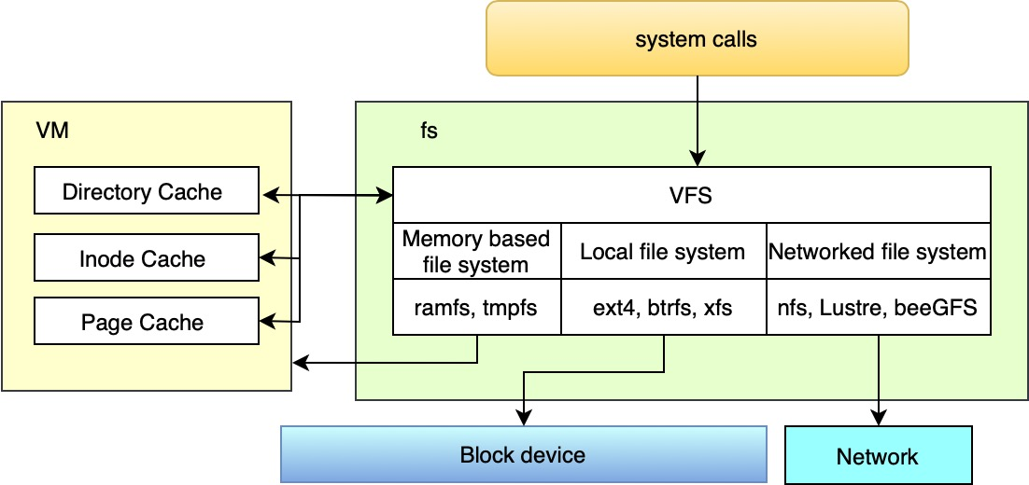
Linux Virtual File System (VFS)
VFS layer provides is a uniform I/O cache:
icache: inode cache
dcache: directory dentry cache
Page cache: combine VM and file data
Memory-based File systems (ramfs/tmpfs) take advantage of the VFS natural characteristics, especially using the existing Linux VFS caching infrastructure
Storage Tier – latency vs. cost

Slide 4
Memory-based File System – ramfs/tmpfs
Advantages:
Export kernel caching mechanism (dcache, icache, page cache)
It works within the virtual file system (VFS) layer
Use the natural characteristics of VFS, does not need format
the read and write speed is very fast, Provide best performance among all VFS-based file systems
Disadvantage:
There is no backing store;
There is no persistence guarantee: the filesystem disappears after a system reboot, power cycle or unmount
OOM: ramfs may fill up all memory. To prevent from exhausting all memory, a derivative called tmpfs implements size limit for caching:
page cache size for caching file data;
the maximum number of inodes.

Slide 5
Motive
Memory-based file systems outperform nearly all file systems based on VFS. This inspires our novel writeback caching idea for both data and metadata:
Embed a memory-based file system (MemFS) into the main Lustre file system based on the persistent storage medium;
I/O data first tries to write into the embedded MemFS;
Using kernel writeback mechanism, delay writing back dirty data from MemFS into the main Lustre file system;
Even using low speed storage medium (HDD), in some cases, it can achieve the high-speed performance close to the memory-based file system, which performance is even better than most of NVM-based file systems;
Ensure the data persistence and durability;
Do not break any POSIX semantics;
Space management

Slide 6

02
DESIGN & IMPLEMENTATION
Rethink Writeback caching

Slide 7
Caching in current Lustre
Metadata intensive workloads are still to bottleneck due to:
namespace synchronization
lock contention on directories
transaction serialization
RPC overloads.
Caching in current Lustre file system:
Data I/O are full cached on clients in face of no contention under the protection of page-granularity extent locks.
For metadata, only read (such as dentry, stat() attributes) are cached under the protection of DLM locks; All modifications or even open() need to communicate with MDS.
Almost all networked file systems, such as NFS, GPFS, beeGFS and Lustre so on, metadata operations need to be synchronized to the server by using heavy RPCs.

Slide 8
General Idea
Our WBC is a client driven writeback caching mechanism, especially for metadata operations.
It allows applications to process their own metadata or even data I/O locally without server intervention.
Through the use of DLM lock mechanism, it can provide high-performance cache service and maintain strong consistency of file system access at the same time.
To prevent from exhausting all virtual memory on a client, MemFS allows an administrator to specify a maximum upper bound for the caching limits in two aspects:
page cache size for caching file data;
the maximum number of inodes.
When reach limits, allow to cache partial subtree on the client.

Slide 9
Lustre WBC Working Principle
Exclusively lock new directory at mkdir time
The DLM lock cached in client-side DLM lock namespace;
Protect the client exclusive access to the entire directory subtree;
All newly creation in the directory can be cached into the embedded MemFS without RPCs.
Cache new files in MemFS until cache flushes.
Flush partial subtree immediately to the server when reached the limit of inodes or page cache.
Flush files immediately to the server due to other client conflict access / lock callback:
Push top-level entries to the server, exclusively lock new children subdirs, drop parent EX DLM lock;
Repeat as needed for subdirs of namespace being accessed remotely;
Flush reset of tree within MemFS in background to the server by age or memory pressure:
Too much time has elapsed since the file has stayed dirty in MemFS;
under memory pressure;

Slide 10
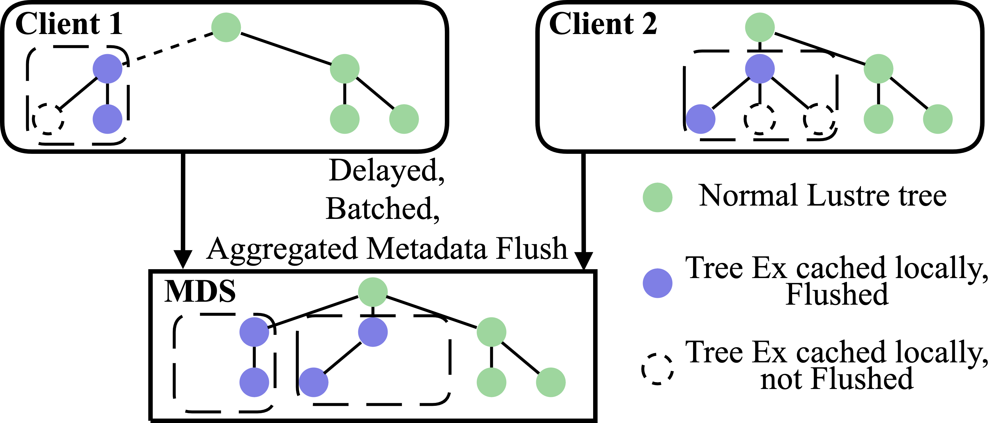
MetaWBC
MemFS key points:
Developed for MetaWBC with design and implementation similar to tmpfs
Hooks into Linux VFS for memory pressure/flushing
Offers support to persist data and metadata to the backend DFS
Visible namespace for MetaWBC cached in MemFS

Slide 11
File State Machine for Lustre WBC
Define different states of a file, take proper action accordingly:
Root(R): It is the directory holding the root WBC EX lock.
Protected(P): indicates that the file is directly or indirectly protected by an EX WBC lock.
Flushed(F): The file metadata has been flushed back to the server (main Lustre file system);
Complete(C): The file is marked with P flag and protected by a root WBC EX lock. Under this state, all its children dentries are completely cached in embedded MemFS. The result of readdir() or lookup() can be obtained directly from embedded MemFS and all file operations can be executed locally in MemFS. If a file is not marked with C flag, the create/unlink/readdir/lookup operations within this directory need to be synchronized to the server (main Lustre file system);
Assimilated (A): mainly used for regular files, indicating that the page cache of the file has wholly assimilated and committed from embedded MemFS into the main file system. The life cycle of these pages is now managed by the main file system not the embedded MemFS. These pages are no longer pinned in MemFS, changed from unevictable to reclaimable.
None(N): The file is not or no longer charged by embedded MemFS. The main file system is now responsible for the manage of its life cycle.

Slide 12
sync & fsync operations - Persistence
sync and fsync operation:
An fsync on a file or directory must ensure that all changes to that file or directory, at the time fsync was called, are flushed to the persistent storage.
As the subtree is cached within client-side MemFS, may not be flushed and inconsistent with the subtree on the server.
To ensure the file and directory entry is durably stored in the persistent storage on MDS, it must ensure all its ancestral directory must be flushed as well when fsync was called.
To achieve this goal, MemFS needs to reverse backtracking to its first ancestral directory that is synchronized to the server. And then synchronize from this ancestral directory to the node called fsync() in top-down order.

Slide 13
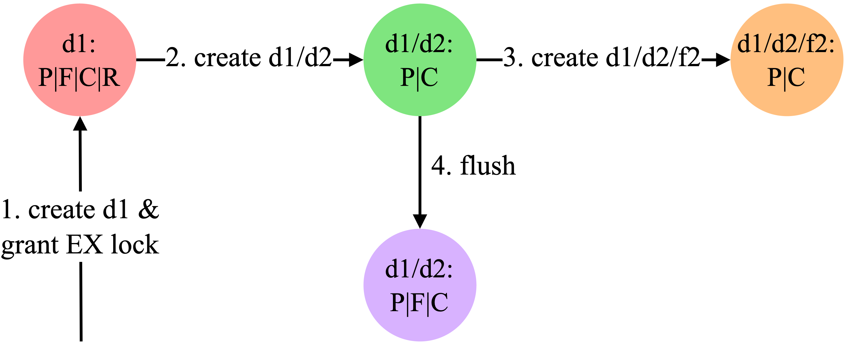
MetaWBC cache state machine
MetaWBC assigns caching state flags to inodes
Root (R): Cached subtree root and holder of EX lock
Protected (P): Directly or indirectly protected by EX DLM lock
Flushed (F): Metadata has been flushed
Complete (C): Directory flag indicating entire subtree is cached
Assimilated (A): Regular file flag indicating cached file pages have been flushed
None (N): Not managed by MemFS
Creation and flush work flow
d1 created on server with EX lock
d2 created locally
f2 created locally
d2 flushed by age, space

Slide 14
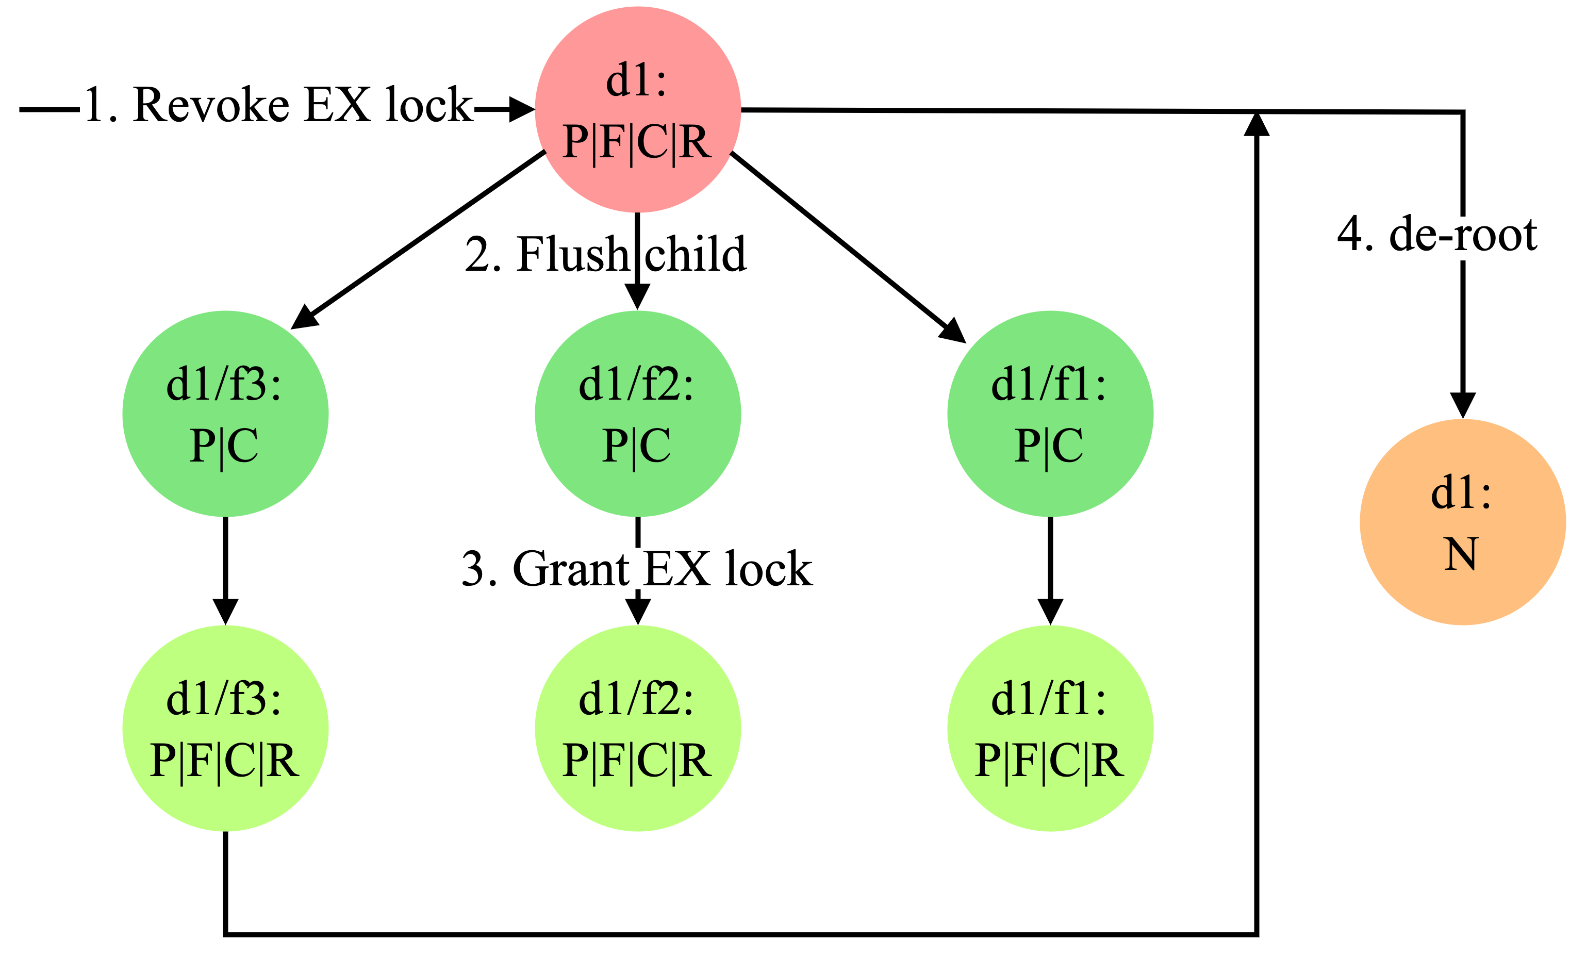
MetaWBC cache state machine (cont’)
MetaWBC assigns caching state flags to inodes
Root (R): Cached subtree root and holder of EX lock
Protected (P): Directly or indirectly protected by EX DLM lock
Flushed (F): Metadata has been flushed
Complete (C): Directory flag indicating entire subtree is cached
Assimilated (A): Regular file flag indicating cached file pages have been flushed
None (N): Not managed by MemFS
- Each children file will be flushed to the server (main file system);
- At the same time, the server grants the WBC EX lock to each top-level children file;
- The state of each children file within the directory changes from the original state S’ to S’|R|F;
- Finally, the original root WBC directory is marked with N state;
- After de-root, all children files under the directory are visible in cluster wide;
De-root work flow
Conflict/age/space on d1
Flush all top-level entries of d1
EX lock on all top-level entries
Drop d1 lock
Repeat on as needed

Slide 15
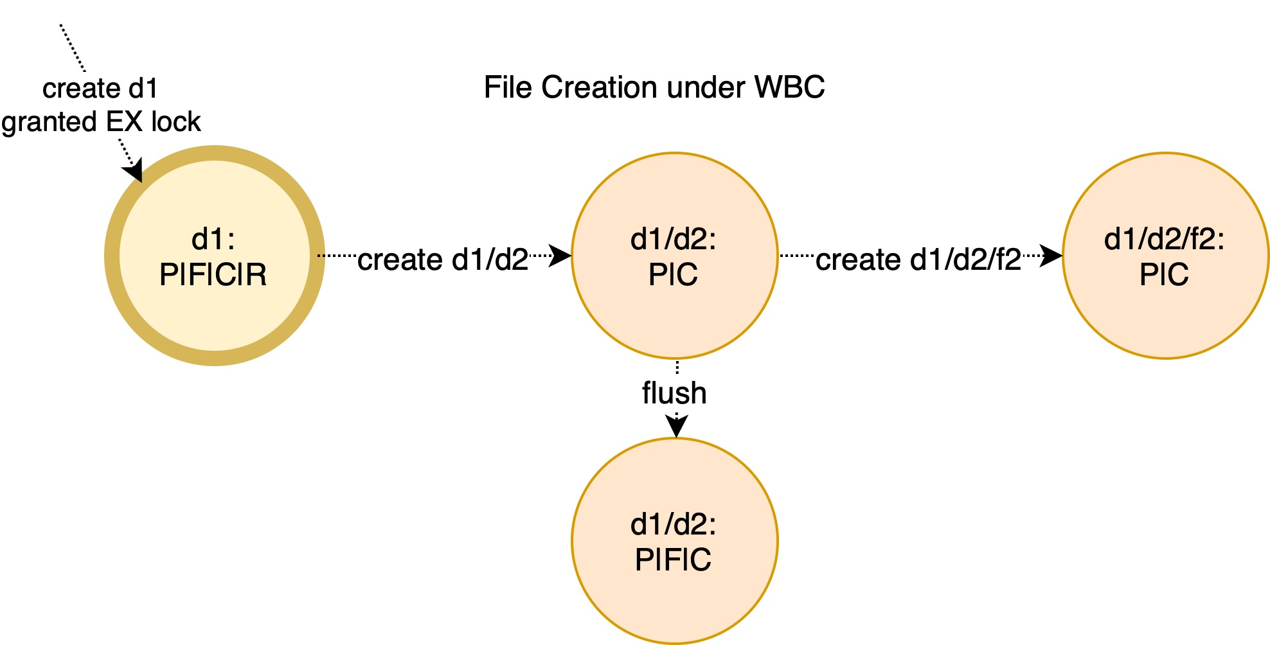
de-complete
de-complete: when create new file under a directory marked with C flag, if fail to reserve inode due to reaching the upper limit for inodes in MemFS, it must first de-complete the directory:
The directory and all its ancestor directories must be first flush back to the server;
all the children file within this directory must flushed back to the server too;
Unmask C flag from the file state;
Readdir/lookup() on a directory (~C) must go to the server;

Slide 16
Data Commit for page cache
A regular file is protected by a root WBC lock and the file data is still in page cache of the embedded MemFS (～A)
if the number of pages used by the client does not reach the predefined maximum capacity limit of MemFS (i.e. 16GiB in total) or the memory usage limit of per-file for data (i.e. 100MiB per file data in MemFS), consume the page from page cache limit in MemFS and write the data to MemFS;
Otherwise, the regular file needs to be flushed to the server. Data page assimilation is submitted to the main File system.
set the state S of the file to S | = F | A, and then retry the data writing operation;
For a regular file in the assimilated commit (A) state, all data I/O will be switched from MemFS to the main file system.

Slide 17
Other operations under MetaWBC
Stat() calls can obtain all attributes locally
Reopen
Lustre is a stateful filesystem. Each open keeps a state on the MDS.
We must keep transparency for applications once the EX WBC lock is cancelled.
To achieve this goal, each local open will be recorded in the inode’s open list;
When the EX WBC lock is cancelling, it must reopen the files in the open list from MDS.
Hardlink() and rename()
First de-root both source and destination parent directory;
And then perform the operation synchronously on the server by using the normal patch without MetaWBC;

Slide 18
Flush mode – drop/keep modes
Four mode: lazy_drop, aging_drop, lazy_keep, aging_keep
'drop' mode:
when flush dirty data under background, it will de-root (drop the root EX WBC lock) level by level.
In the meanwhile, the reserved inodes and data pages in MemFS are reclaimed for the sequent I/O.
'Drop' mode can accelerate the reclaim, which is generally used for the application with only one time of reading/writing.
'keep' mode:
the root WBC EX lock on the root WBC directory will not be actively revoked unless a remote access conflict happens.
Under the protection of the root WBC EX lock, almost all operations of the files within the entire subtree can be performed locally without interaction with the remote server.

Slide 19
Four Flush mode – lazy/aging mode
'lazy' mode:
the kernel usually does not actively flush dirty data.
It is generally used in the rich memory environment.
The application writes data to the embedded MemFS (while the main file system is Lustre) as much as possible to avoid the negative performance impact of the background cache writing back on the I/O in the foreground, so as to obtain the best performance.
After the data is written, the data can be persisted to the main file system (Lustre) in an explicit way, such as a sync() call.
For 'aging' mode, it uses the writeback mechanism in the Linux kernel.
The aged dirty data in embedded MemFS is periodically written back to the main file system (Lustre) through the dedicated flusher thread on background, achieving a balance between high performance and data persistence.
For various reasons, it is best to minimize the dirty data cached in embedded MemFS, so as to minimize the time required to persist dirty data, and minimize the amount of unsynchronized data between embedded memory file system(MemFS) and main file system (Lustre), so as to minimize the amount of data lost in case of system failure.

Slide 20
Linux kernel writeback setting
Variable | Description
dirty_background_ratio | As a percentage of total memory, the number of pages at which the flusher threads begin writeback of dirty data.
dirty_expire_centisecs | In milliseconds, how old data must be to be written out the next time a flusher thread wakes to perform periodic writeback.
dirty_ratio | As a percentage of total memory, the number of pages a process generates before it begins writeback of dirty data.
dirty_writeback_centisecs | In milliseconds, how often a flusher thread should wake up to write data back out to disk.

Slide 21
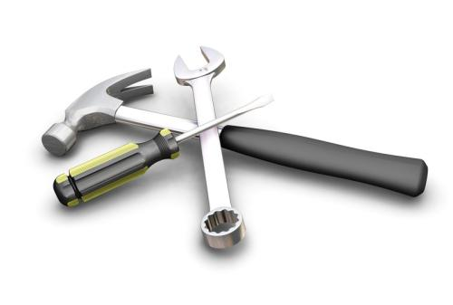
03
NEW CHALLENGE & FEATURE
RETHINK WRITEBACK CACHING

Slide 22
Inode and space grant algorithm
The server grants each client an initial inode and space grant at the connection time. i.e. space 64M; initial inode grant 256K.
When the client grant is sufficient, the space or inode grant is consumed, and the file data is written in WBC mode;
Each RPC to the server will contain the amount of reserved space, usage and consumption speed. According to the total free amount of disk on the server and the information sent by the client, the server appropriately updates the amount of space grant to the client, and piggy-back it to the client in the reply.
When the client grant is exhausted, the client I/O must be performed to the server in a synchronous manner. This allows you to report -ENOSPC errors as soon as possible.
If the client has no write activity for more than a certain time interval (the default is 1200 seconds), it will automatically reduce its own space grant. If the server space is insufficient, the grant amount will be recycled.
Currently there is no server-initiated recycle mechanism for client grant, but it will not cause the loss of server space capacity. Only when the server space is insufficient, all IO operations must be performed in a synchronous manner to the server.

Slide 23
Space Management
MetaWBC must ensure that the backend file system has enough free space before caching data and metadata.
Otherwise, the backend file system might run out of space during write-back and it might return an ENOSPC error, which comes too late to be captured by the application that has originally performed the I/O.
In cases where the remaining space of the main file system is less than 1/8 of its total capacity, or less than two times of the total capacity limitations of all clients’ MemFS, MetaWBC switches from caching I/Os to perform I/Os synchronously to the server.
In this context, we plan to implement a space reservation and delay allocation mechanisms as part of future work to avoid a situation where too much data is cached.

Slide 24
Cache Reclaim Mechanism
The capacity of the embedded MemFS is limited by the size of the system memory. Thus cache reclaim mechanism is designed to reclaim inodes and data pages for subsequent I/O to make full use of the caching service.
When the client starts, a dedicated kernel daemon thread is created to recycle. When it is detected that there are too many inodes or dirty data pages in the cache, it will wake up the daemon thread to recycle until the cache amount is below a threshold.
The reclaim for inodes is done via de-complete the directories. All children dentry under the directory will be evict from MemFS;
The reclaim for page cache is done via assimilation of data pages for a file.
Control number of children file under a directory (when reached the limit, de-complete the directory); Or limit the number of data pages consumed by a single file, once reached assimilate it.

Slide 25
Metadata WBC introduces new features for metadata updates
Metadata update compact:
The create and subsequent multiple setattr calls can be absorbed and merged into one metadata update;
unlink() or rmdir() on non-flushed file can directly execute locally in MemFS, no any RPC calls.
Batched metadata updates:
Select a subtree in MemFS, batch the metadata updates under the subtree into a large RPC request (or bulk data transfer).
When received the batched request, the server executes the updates one by one;
How to avoid dependence among batched metadata updates, especially in DNE (multiple metadata servers) environment?
How to divide the subtree in MemFS to generate the batched metadata updates more efficiently?
In current Linux kernel, there is only one working flusher thread for a filesystem instance. How to implement multithreaded batched metadata updates and meanwhile avoid dependence?

Slide 26
File deletion Policies
After introduced metadata WBC, the file deletion operation can be optimized according to file state
Sync deletion:
When the file has flushed (F flag), synchronize the deletion on the server, and then delete in MemFS;
Free the space used by deleted file as soon as possible;
Delay deletion:
Each directory in (C) state maintains a list L for deleted files. When deleting a children file in the directory, if the sub file has been flushed (F), the file is added to the list L, and the directory is marked as dirty. Finally, the file is deleted from MemFS (not delete from the main file system now);
2. When deleting a directory in (C) state, if its parent directory is also in (C) state, it can splice the deleted file list of the directory two list into the deleted file list of its parent directory; otherwise, it needs to synchronize to delete the files and directories in the deleted on the server.
3. When the background flusher wakes up and it will check whether the L is empty. If it is not empty, the files in L will be deleted in batches according to the file FID;
a
b
c
d
e
f
g
h
i
rmfid e f i g h
Batched deletion

Slide 27
File Deletion Policy – cont’
Subtree deletion:
The file deletion policy is similar to the batched deletion policy;
The difference is that: when the parent directory is in C state and a directory under the parent directory is to be deleted, not splice two lists, and the directory is directly added to the deleted file list L of the parent directory.
Since the client has exclusive access to the directory, it indicates that the whole subtree has been removed from the file system.
When the file is being deleted in the background flusher thread, only the FID of the root node of the subtree is passed to the server.
After receiving the deletion request, the server can reply to the client immediately, and then delete the subtree asynchronously in the background.
a
b
c
d
e
f
g
h
i
rmfid e
subtree deletion

Slide 28
Integrate PCC with WBC
The memory size on a client is limit compared with the local persistent storage such as SSDs.
For a WBC subtree, its metadata can be reasonably whole cached in MemFS. But data for regular files maybe grows up too large to cache on client-side MemFS.
PCC can be used as the client-side persistent caching for the data of regular files under protection of EX WBC lock.
The PCC copy stub can be created according to FID when create the regular file on MemFS and then all data I/O are directed into PCC. Or when the regular file growing too large for the client memory, attach the file into PCC.
All these operations do not require interaction with MDS until flush is needed. During flushing for a regular file, it just needs to set the file with HSM exists, archived and released on MDT. The file data cached on PCC can defer resync to Lustre OSTs or evict from PCC when it is nearly full.

Slide 29
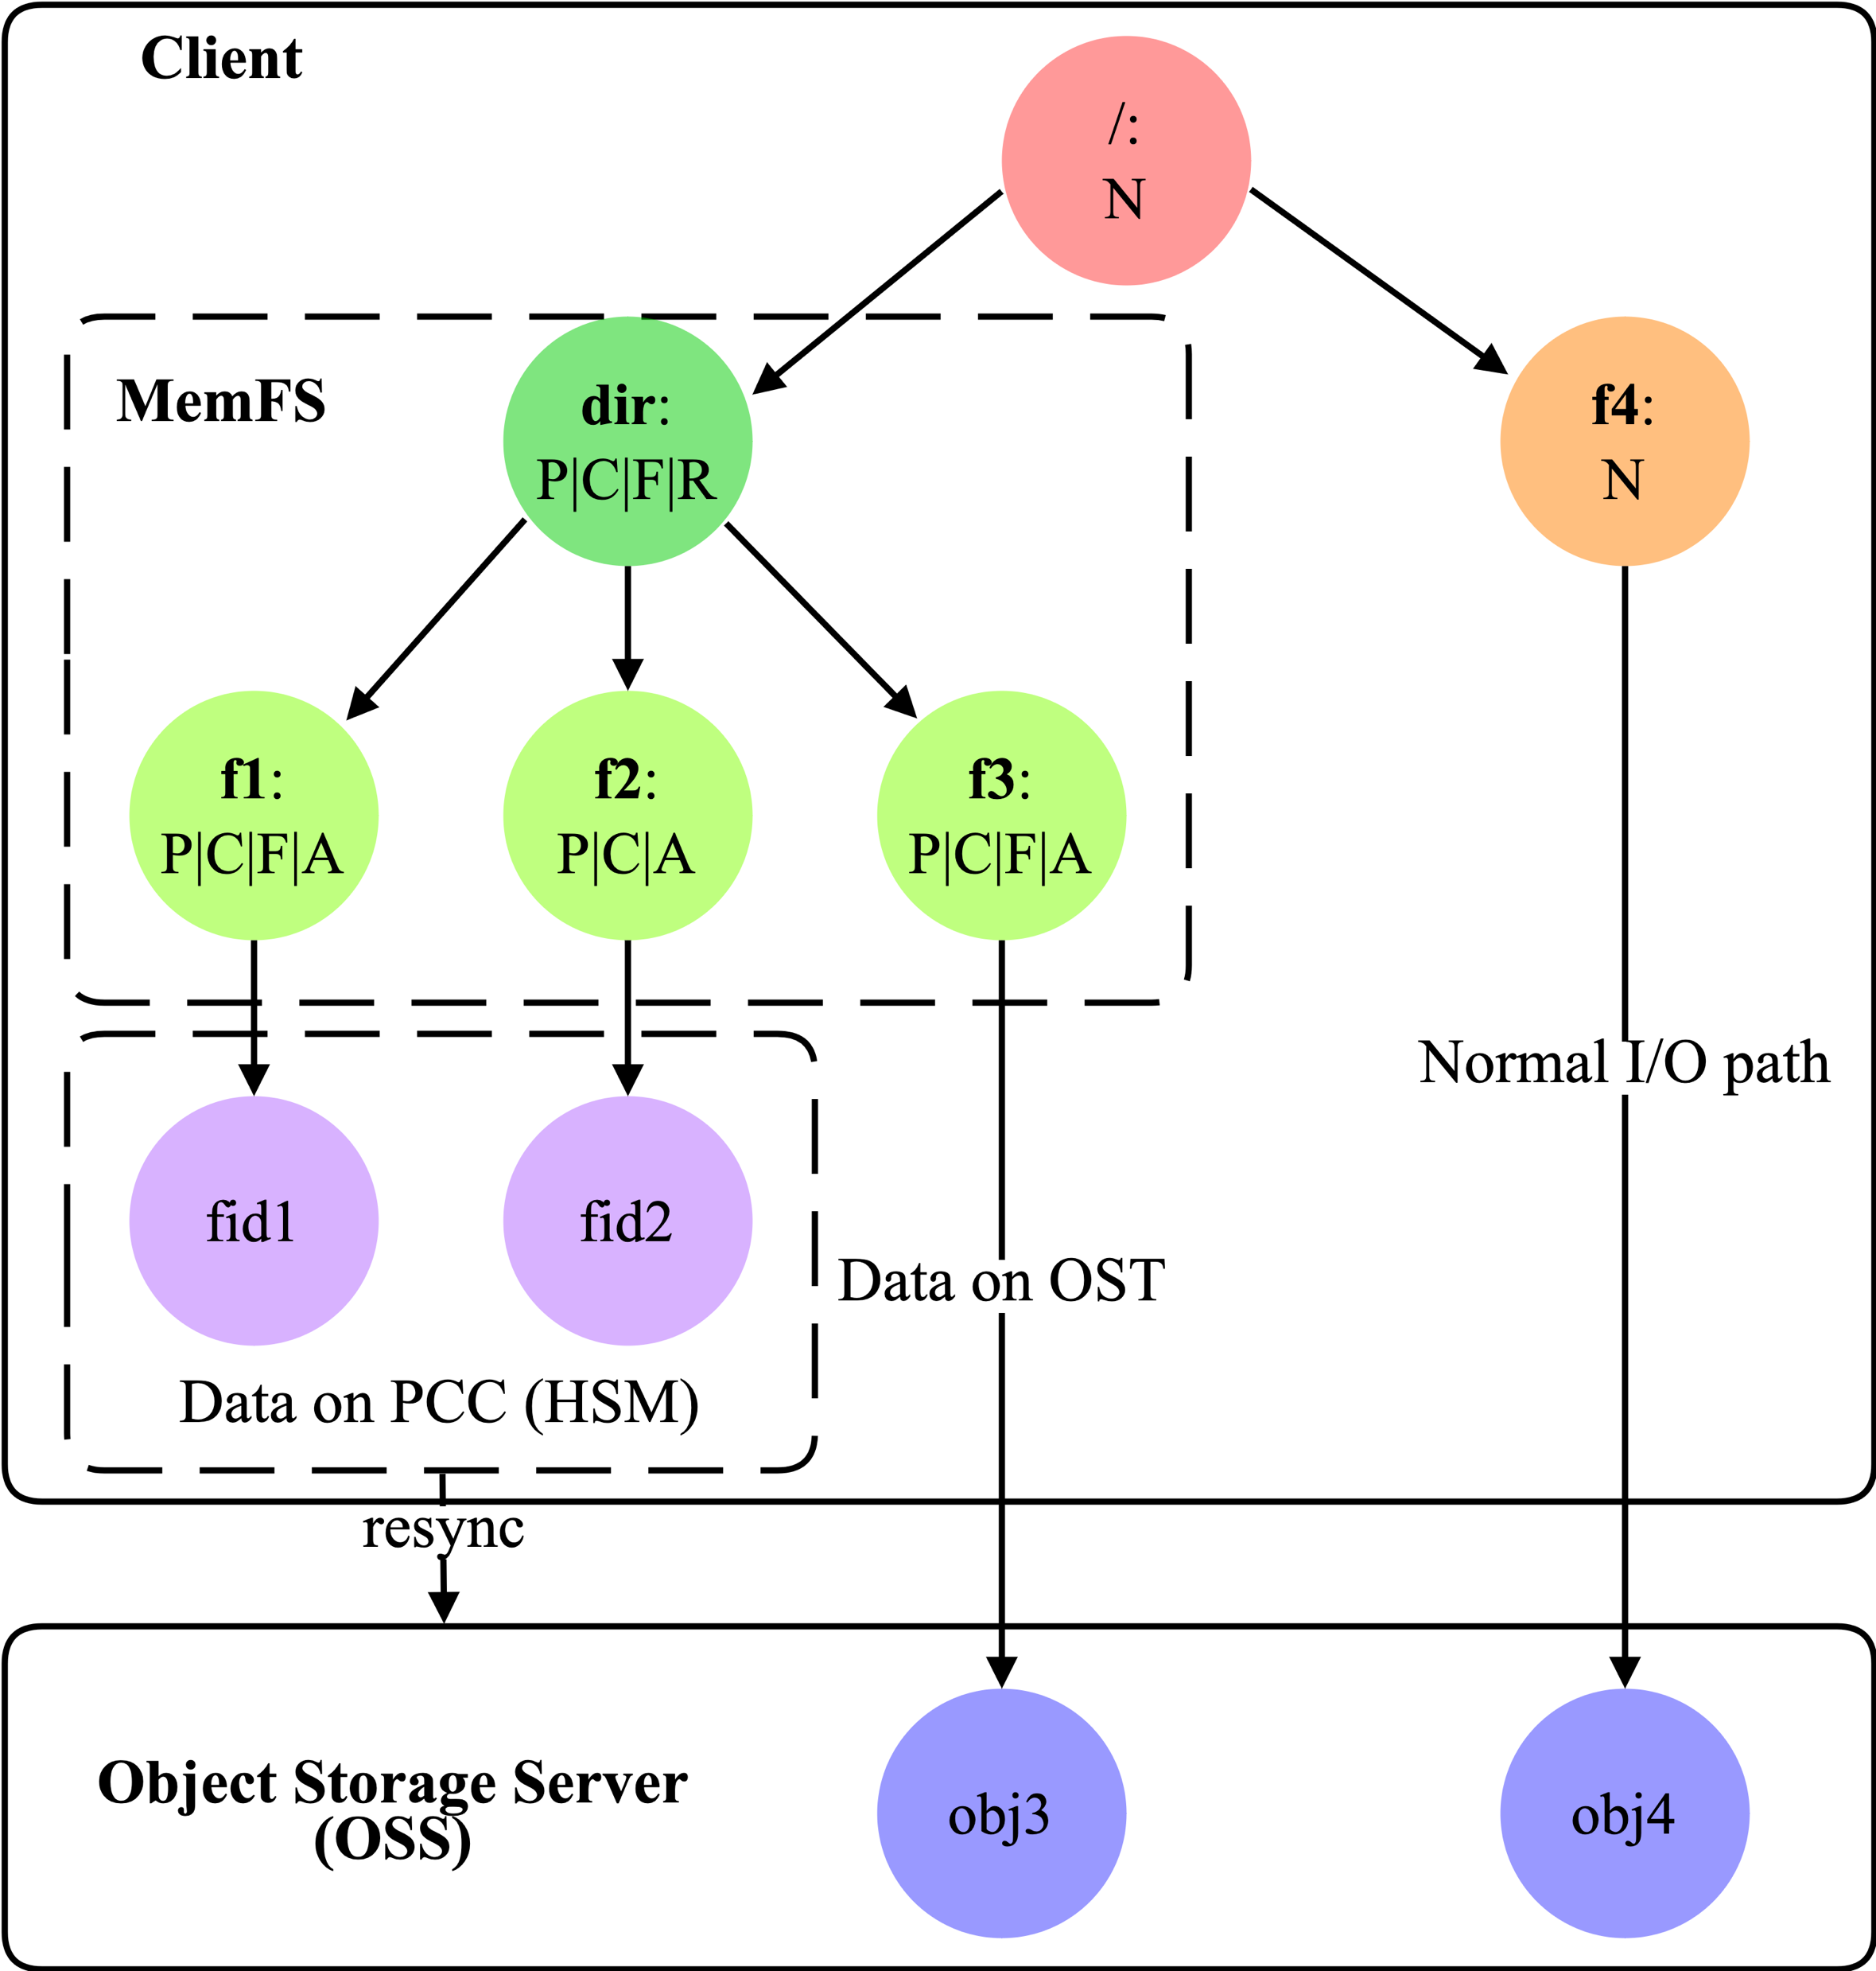
Integrate PCC-RW with MetaWBC
Use HSM mechanism to sync the data from local PCC device to the Lustre OSTs.
Not a Persistent Client Cache for metadata, Only for data;

Slide 30
04
EVALUATION

Slide 31
Evaulation
Lustre 2.14.0 cluster with CentOS 8.4
1 Meta Data Target (MDT)
8 Object Storage Targets (OSTs)
Servers using DDN AI400X Appliance (20x Samsung 3.84 TiB NVMe, 4×IB-HDR100)
32 client nodes using Intel Gold 5218 processor, 96 GiB DDR4 RAM, IB-HDR 100
Max. number of inodes in MemFS: 2,000,000 (MemFS inode limit)
Max. page cache size on clients: 16 GiB (MemFS block limit)
Evaluate MetaWBC in micro benchmarks and real-world workloads
MetaWBC comparison with Ext4, NFS, tmpfs, and CephFS

Slide 32
Evaluation – Single node Metadata peformance
Single node mdtest metadata performance (16 proc. per node @ 100K files per proc.)

Slide 33
Evaluation - Multiple node metadata performance
MetaWBC mdtest metadata performance scaling (unique dir)

Slide 34
Evaulation – Single node data performance
Single node IOR I/O performance (16 proc. per node @ 16 GiB/proc.)

Slide 35
Evaluation – Multiple node data performance
MetaWBC + LPCC write throughput scaling

Slide 36
Evaluation – real-world workload
Compare various workloads to other file systems on a single node
filebench default workloads (1 minute runtime)
Common command line applications operating on the Linux kernel source code
App. | NFS | Lustre | MetaWBC | Ext4 | tmpfs
cp -rf | 64.00 | 48.00 | 5.10 | 1.24 | 0.75
find -uid | 2.89 | 2.48 | 0.10 | 0.71 | 0.09
du -s | 2.84 | 2.34 | 0.10 | 0.70 | 0.08
ls -lRU | 3.40 | 1.57 | 0.28 | 0.93 | 0.29
grep -r | 15.59 | 16.58 | 1.08 | 15.82 | 0.46
Filebench workloads’ throughput
Command line applications’ runtime (in seconds)
MetaWBC performs between local FS and memory speeds

Slide 37
Evulation – CephFS asynchronous directory operation
CephFS supports asynchronous directory operations to boost metadata performance by allowing clients to perform directory operations (create, unlink) locally without waiting for synchronous acknowledgment from the Metadata Server (MDS).
This technique uses delegated capabilities and inode number delegation, reducing latency for file creation and deletion, particularly for high-concurrency workloads.

Slide 38
Evalution – MetaWBC vs. CephFS
Single node mdtest performance

Slide 39
Decompress a Linux source code package
File type | tmpfs | Ext4 | NFS | Lustre | Lustre on WBC
tar | 0.7s | 1.3s | 315s | 82s | 9s
tar.gz | 4.8s | 4.8s | 308s | 81s | 10s
Compared with networked File systems by metest (np = 1)
Ops/sec | File creation | File stat | File read | file removal
NFS | 1,941 | 11,039 | 4,991 | 2,197
Lustre | 3,837 | 6,518 | 5,671 | 6,608
Lustre WBC | 370,981 | 767,049 | 505,199 | 456,030

Slide 40
Performance for IO500 mdtest-easy (unique dir workload)
IO500 mdtest-easy performance for MetaWBC is not very good as it calls sync() at the end phase;
The performance is limited by current Per-BDI thread model;
Mdtest 16 rank creates files in parallel, but there is only one thread writebacks the file to MDTs.
The performance suffers Even using batch create in MetaWBC.
Current and Historical Implementation
Per-BDI Thread Model: Since kernel version 3.2, Linux replaced the older pdflush mechanism with a per-BDI writeback thread model. Each storage device (BDI) has a single associated kernel writeback thread.
The Bottleneck: Even with per-BDI threads, the process is still single-threaded per device, as each BDI has a single list of inodes and a single work instance to process. This design can limit I/O throughput, especially with fast, high-capacity SSDs and demanding parallel workloads.
Purpose: The writeback threads flush dirty pages from the kernel's page cache to the disks, either due to memory pressure, an explicit fsync() call, or a periodic timer.

Slide 41
Ongoing Developments for Multithreaded Writeback
The Linux kernel community is actively developing and integrating changes to parallelize the filesystem writeback process. The goal is to leverage the multiple cores available in modern systems more effectively. https://lwn.net/Articles/1024402/
Key aspects of these developments include:
Multiple Contexts: Patches have been proposed and discussed to add an array of "writeback contexts" (struct bdi_writeback_ctx) to the BDI structure, allowing for multiple threads to perform writeback for a single BDI simultaneously.
Filesystem Awareness: The proposed changes aim to split the writeback work based on filesystem geometry (e.g., XFS allocation groups) to enable high-level parallelism.
Configuration: There is ongoing work to add sysfs configuration options to control the number of writeback contexts.
Improved Performance: Early experiments show that parallelizing writeback improves throughput and responsiveness, particularly for sustained-write workloads with large memory footprints.
Users experiencing I/O latency or stalls due to current writeback behavior can adjust sysctl parameters like vm.dirty_ratio and vm.dirty_background_ratio to influence when writeback begins, or ensure they have fast storage.
In Lustre side, the client can do batch creation asynchronously in the user thread context when detect that there are a number of unflushed files (1024) within a directory under MetaWBC.

Slide 42
05
Conclusion & FUTURE WORK

Slide 43
Disconnected Operation Support
A common problem facing ubiquitous computing and mobile users is disconnected operation. It is necessary for mobile devices to handle the data in disconnected state.
For some special use cases, a directory may be unique accessed by a client. For this directory, it can be entirely WBC cached and exclusively access on the client.
As both metadata and data can be stored on PCC, nearly all I/O operations under the root WBC directory can be executed locally once the client was disconnected from the servers in the disconnected mode.
Flushing in the disconnected mode should be deferred until the connection recoveries.
When a mobile device (a Lustre client) reboots after crash or power off manually, and the connection to the server recovered, the client needs to reintegrate the cached data with main file system (Lustre)

Slide 44
Conclusion & Future work
We have presented MetaWBC – a novel metadata write-back mechanism for DFSs
We integrated MetaWBC into Lustre using the EX lock to provide strong consistency
Key technologies: MemFS, metadata batching, async. parallel flush, subtree removal strategy
MetaWBC improves Lustre performance by up to 8x in metadata-intensive workloads
Productization of MetaWBC code is well underway for Lustre version 2.17+ ^{[LAD22]}
Future work
Failure and recovery handling
Metadata operations for existing directories
Support for disconnected operations like coda file system
Extend LPCC to cache metadata
Optimize hardlink() and rename() if all files involving are caching under MetaWBC on a client;
Quota support under MetaWBC

